Slide 1
Foundations of Modern Software Systems
Module-3: Compute
Instructor: Piyush Goel
N.M.A.M. Institute of Technology

Slide 2
Module-3:Compute, Lecture-4

Slide 3
Recap

Slide 4
Recap
Process
Structure of a Process (Data Section, Code Section, Local Section)
Memory Layout
Controls (Creation, Termination, Priority Management, Signals/Interrupts)
Threads
Execution component of a Task.
Process does the book keeping, and hands-over the execution to a Thread.
Scheduling
OS Scheduler maximises CPU utilisation, and maintains fairness across tasks.
Tasks can get pre-empted out of the CPU
Time Slice Finished, Higher Priority Task comes in.
Signals/Interrupts, etc

Slide 5
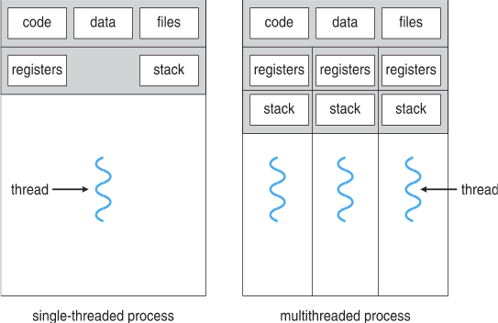
Threads

Slide 6
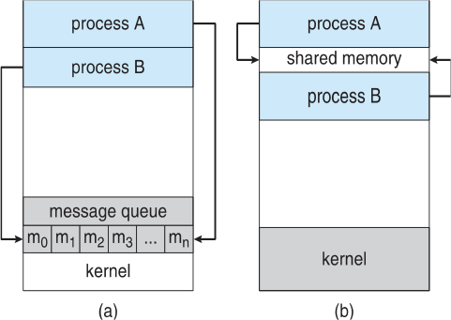
Inter-Process/Thread Communication
Processes of Threads within a system may be independent or cooperating.
Independent
Data Shuffling
Cooperating
For coordinated execution.
Example MergeSort
Process Communication
Shared Memory
Shared segment of memory to which
data is written.
Message Passing
Queues

Slide 7
Inter-Process/Thread Communication
Threads share the processes address space. A lot easier to communicate.
Communication for Synchronisation
Synchronisation Examples
MergeSort
Maggi & Coffee
Friends Meeting for dinner.
Ordering Food at a Food court.
Entering/Exiting the Auditorium.
Turnstiles at a Security Counter.

Slide 8
Communication Models
Blocking && Non-Blocking (Examples)
Blocking is considered synchronous
Blocking send -- the sender is blocked until the message is received
Blocking receive -- the receiver is blocked until a message is available
Non-blocking is considered asynchronous
Non-blocking send -- the sender sends the message and continue
Non-blocking receive -- the receiver receives:
A valid message, or
Null message
Different combinations possible
If both send and receive are blocking, we have a rendezvous

Slide 9
Our World is Asynchronous!

Slide 10
Our World is Asynchronous!
We coordinate really really well knowingly and unknowingly. Machines have to be instructed how to coordinate.

Slide 11
Asynchronous Coordination is hard!

Slide 12
Lecture-4

Slide 13
We will be cooking Maggi and Brewing Coffee in this Module! =)

Slide 14


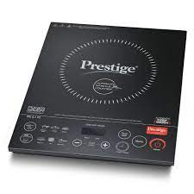

We will be cooking Maggi and Brewing coffee in this Module! =)
* Common Components: Induction Stove, Pan, Spoon, Water
* They will form Global and Shared Variables in our programs as we move along.

Slide 15
Imagine a scenario where you and your sibling want to cook Maggi, and brew Coffee respectively.
You have the ingredients needed, and other kitchen equipments are shared (Induction Stove, Pan, Spoon, Water Jar)
You cannot communicate to your sibling directly. You cannot exchange messages with each other. **
Your mum is present in the kitchen and your communication is limited to her.
She will direct and guide you on the usage of the shared equipments.
The shared equipments are kept at a specific location on the shelf controlled by your mum.
The food specific ingredients are kept in shelves managed by you.
* What could be the reason for this?

Slide 16
Sample Programs for Cooking Maggi & Brewing Coffee.
Take packet(s) of Maggi, and a bowl.
Gather a Washed Pan, Spoon, Induction Stove, Water.
Add Water to the Pan.
Heat the water for 30 seconds.
Add the Maggi Masala and stir it with the spoon.
Let the water and masala boil for 20 seconds.
Break the Maggi cake into two.
Add to the pan.
Stir the Maggi every few seconds.
Keep heating until the water has evaporated and the noodles have softened up.
Turn off the induction Stove.
Pour the Maggi into a bowl, and eat.
Take the coffee beans, the Percolator Pot, a coffee mug, and creamer.
Gather the Spoon, Induction Stove, the Water.
Add the beans with a Spoon to the Percolator Pot.
Add Water to the Pot.
Close the Pot and put it on the Induction Stove.
Heat the Percolator Pot for 5 mins until it starts steaming.
Steam for 2 more mins.
Turn off the Induction Stove.
Pour the coffee from the Percolator Pot into the Coffee Mug.
Add Creamer, and drink the coffee.
* These instructions are nowhere close to a machine understandable procedure.

Slide 17
Sample Programs for Cooking Maggi & Brewing Coffee.
Thread-1
Take packet(s) of Maggi, and a bowl.
Gather a Washed Pan, Spoon, Induction Stove, Water.
Add Water to the Pan.
Heat the water for 30 seconds.
Add the Maggi Masala and stir it with the spoon.
Let the water and masala boil for 20 seconds.
Break the Maggi cake into two.
Add to the pan.
Stir the Maggi every few seconds.
Keep heating until the water has evaporated and the noodles have softened up.
Turn off the induction Stove.
Pour the Maggi into a bowl, and eat.
Thread-2
Take the coffee beans, the Percolator Pot, a coffee mug, and creamer.
Gather the Spoon, Induction Stove, the Water.
Add the beans with a Spoon to the Percolator Pot.
Add Water to the Pot.
Close the Pot and put it on the Induction Stove.
Heat the Percolator Pot for 5 mins until it starts steaming.
Steam for 2 more mins.
Turn off the Induction Stove.
Pour the coffee from the Percolator Pot into the Coffee Mug.
Add Creamer, and drink the coffee.
* These instructions are nowhere close to a machine understandable procedure.

Slide 18
Few Questions to ponder upon!
Can you and your sibling use the Common Components together?
Do you need the Common Components from the beginning until the end of your recipe?
If not, how do you enforce an order or sequence on it?
What if we only need the Induction Stove, the Pan, and Water, and not the spoon? (Reducing the contention on shared objects)
Since you cannot communicate with your sibling, how do you pass the message when you are done using the components?
What if we have two Induction Stoves, two Pans? How does the coordination happen then?
Let’s dive in!

Slide 19
Question 1: Can you and your sibling use the Common Components together?

Slide 20
Question 1: Can you and your sibling use the Common Components together?
Of course not! Unless, you enjoy Coffee flavored Maggi or Maggi flavored Coffee! =)
We need a mechanism to ensure “Orderly Execution” of the processes.

Slide 21
Orderly Execution

Slide 22
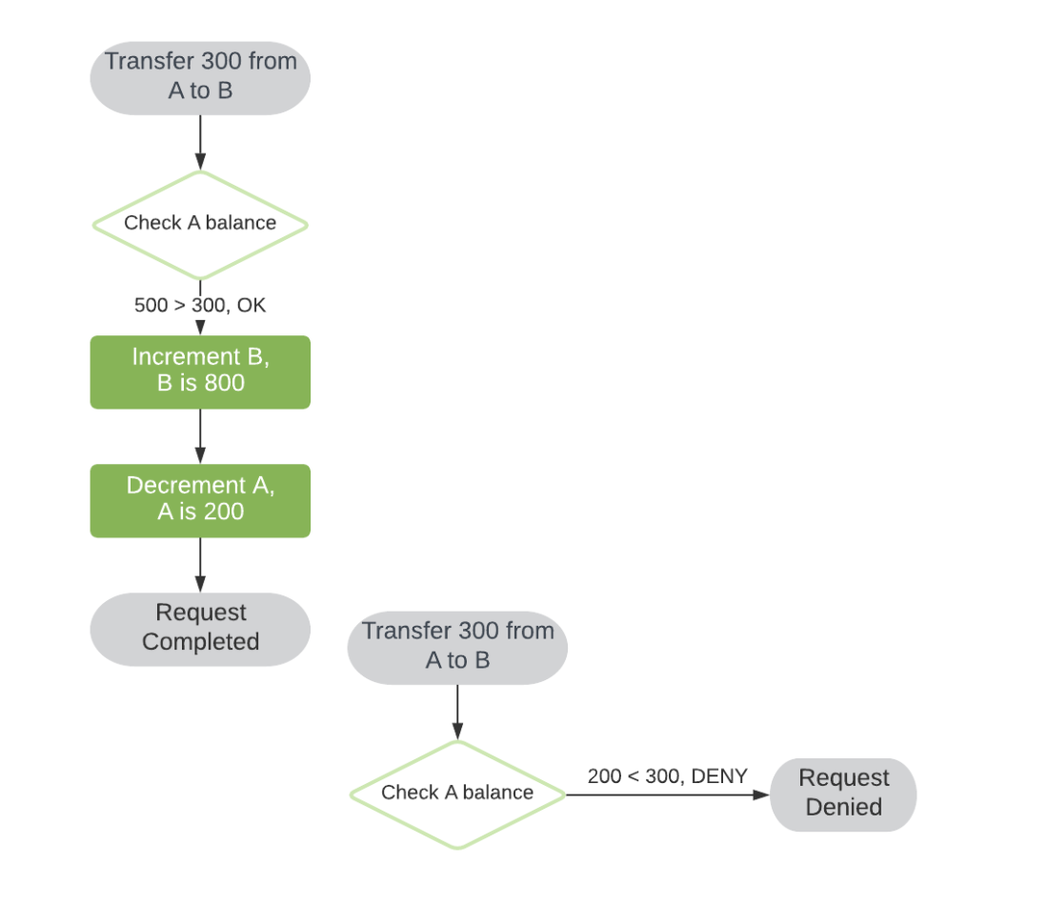
Orderly Execution
Money Transfer across Accounts

Slide 23
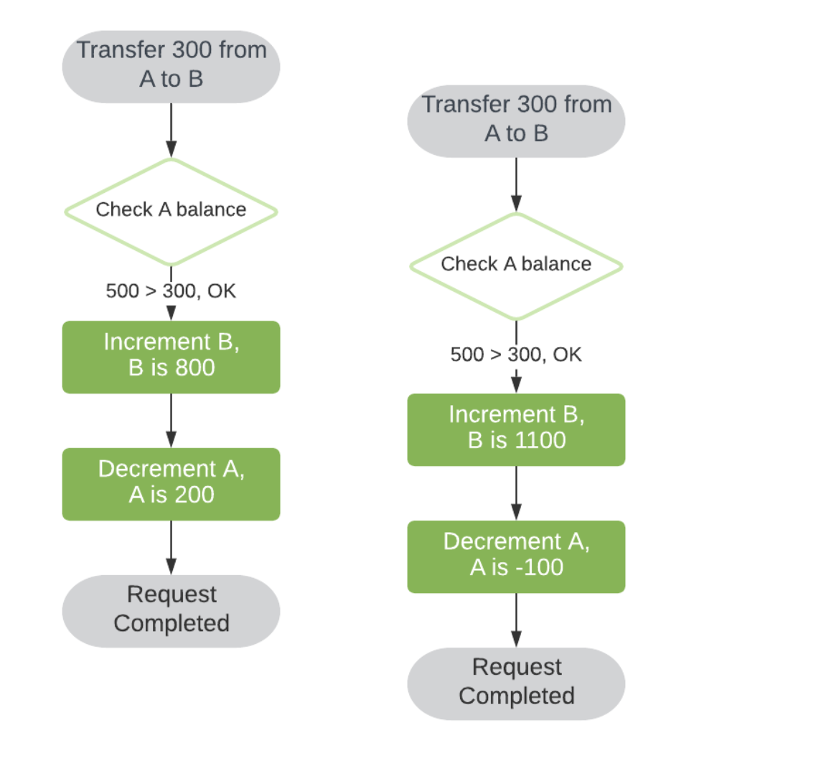
Orderly Execution
What if two transfers are triggered at the same time? (to the nanosecond)
Race Condition
A race condition is a condition of a program where its behavior depends on relative timing or interleaving of multiple threads or processes. One or more possible outcomes may be undesirable, resulting in a bug. We refer to this kind of behavior as nondeterministic.

Slide 24
An Indianised Solution for Orderly Execution

Slide 25
Experiment:
Your mother puts a handkerchief on the slab.
Whoever picks the handkerchief can use the common components.
The other person(s) will have to wait for the handkerchief to be available. There can be a queue of people waiting for the handkerchief.
Once the recipe is finished, the handkerchief is placed back on the slab.
The first person in the queue can pick the handkerchief signaling the use of the common components.
And this goes on…..

Slide 26
Question-2: Do you need the Common Components from the beginning until the
end of your recipe?

Slide 27
Do you need the Common Components from the beginning until the end of your recipe?
Thread-1
Take packet(s) of Maggi, and a bowl.
Gather a Washed Pan, Spoon, Induction Stove, Water.
Add Water to the Pan.
Heat the water for 30 seconds.
Add the Maggi Masala and stir it with the spoon.
Let the water and masala boil for 20 seconds.
Break the Maggi cake into two.
Add to the pan.
Stir the Maggi every few seconds.
Keep heating until the water has evaporated and the noodles have softened up.
Turn off the induction Stove.
Pour the Maggi into a bowl, and eat.
Thread-2
Take the coffee beans, the Percolator Pot, a coffee mug, and creamer.
Gather the Spoon, Induction Stove, the Water.
Add the beans with a Spoon to the Percolator Pot.
Add Water to the Pot.
Close the Pot and put it on the Induction Stove.
Heat the Percolator Pot for 5 mins until it starts steaming.
Steam for 2 more mins.
Turn off the Induction Stove.
Pour the coffee from the Percolator Pot into the Coffee Mug.
Add Creamer, and drink the coffee.
There are limited blocks of instructions that access the shared components (variables).

Slide 28
Critical Section

Slide 29
Critical Section
Thread-1
Take packet(s) of Maggi, and a bowl.
Gather a Washed Pan, Spoon, Induction Stove, Water.
Add Water to the Pan.
Heat the water for 30 seconds.
Add the Maggi Masala and stir it with the spoon.
Let the water and masala boil for 20 seconds.
Break the Maggi cake into two.
Add to the pan.
Stir the Maggi every few seconds.
Keep heating until the water has evaporated and the noodles have softened up.
Turn off the induction Stove.
Pour the Maggi into a bowl, and eat.
Critical Section

Slide 30
Critical Section
Consider system of n processes {p₀, p₁, … p_{n-1}}
Each process has critical section segment of code
Process may be changing common variables, updating table, writing file, etc
When one process in critical section, no other may be in its critical section
Critical section problem is to design protocol to solve this.
Each process must ask permission to enter critical section in entry section, may follow critical section with exit section, then remainder section.

Slide 31
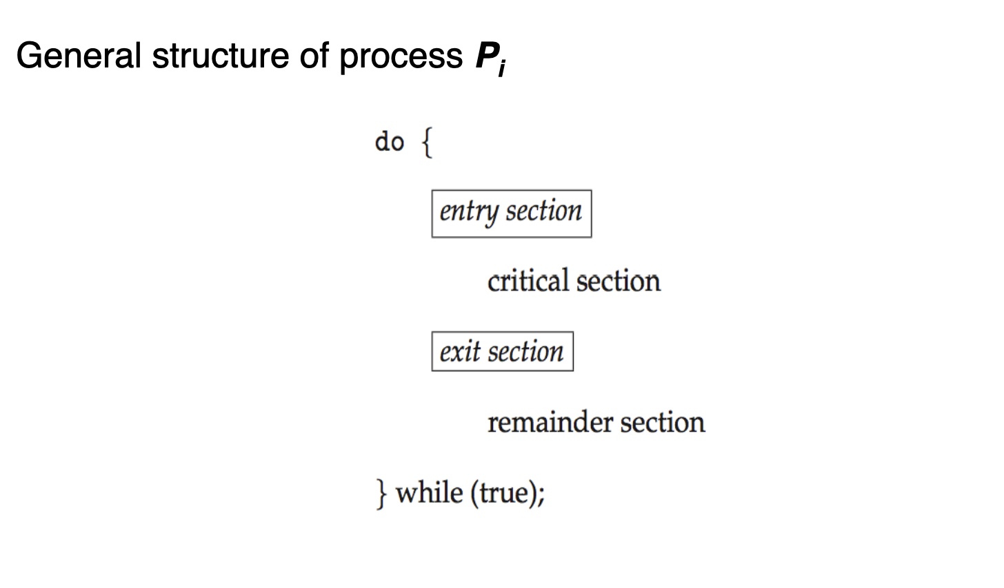
Critical Section
Entry Section - Acquiring Handkerchief from the Slab.
Critical Section - Cooking Maggi
Exit Section - Putting the Handkerchief back on the slab.
Remainder Section - Remaining Steps

Slide 32
Critical Section - Theoretical Construct
1. Mutual Exclusion - If process P_{i} is executing in its critical section, then no other processes can be executing in their critical sections
2. Progress - If no process is executing in its critical section and there exist some processes that wish to enter their critical section, then the selection of the processes that will enter the critical section next cannot be postponed indefinitely
3. Bounded Waiting - A bound must exist on the number of times that other processes are allowed to enter their critical sections after a process has made a request to enter its critical section and before that request is granted
Assume that each process executes at a nonzero speed
No assumption concerning relative speed of the n processes
Mutex === Mutual Exclusion

Slide 33
Question-3: If not, how do you enforce an order or sequence on it?

Slide 34
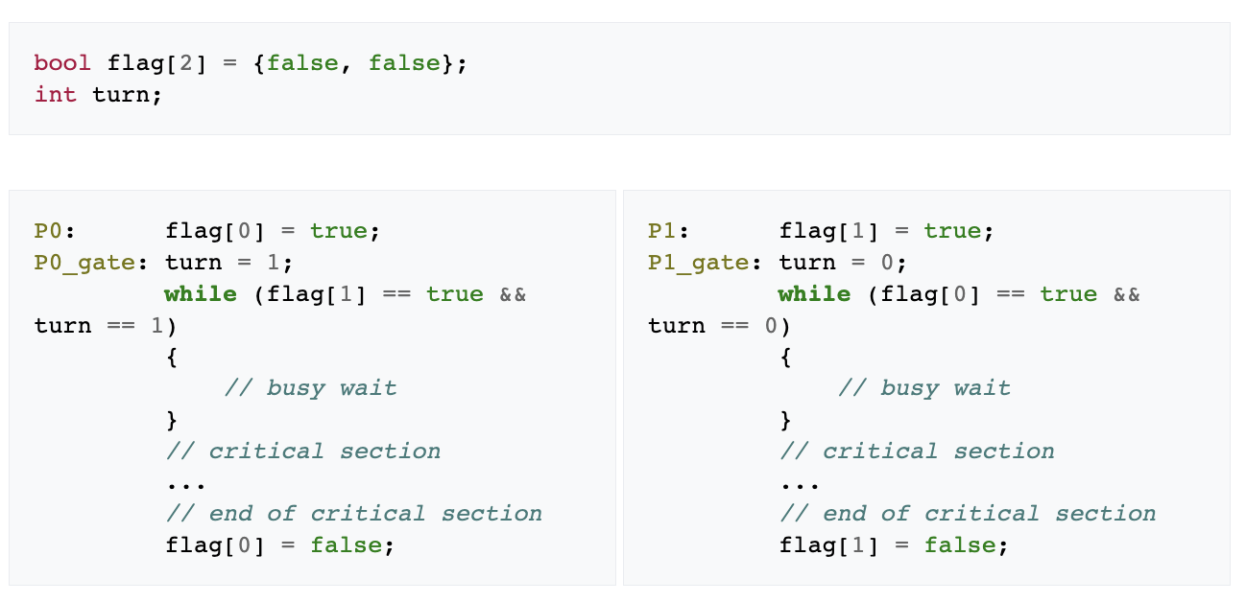
Peterson’s Algorithm
Two Variables
Flag - Representing Readiness
Turn - Whose turn is it.

Slide 35
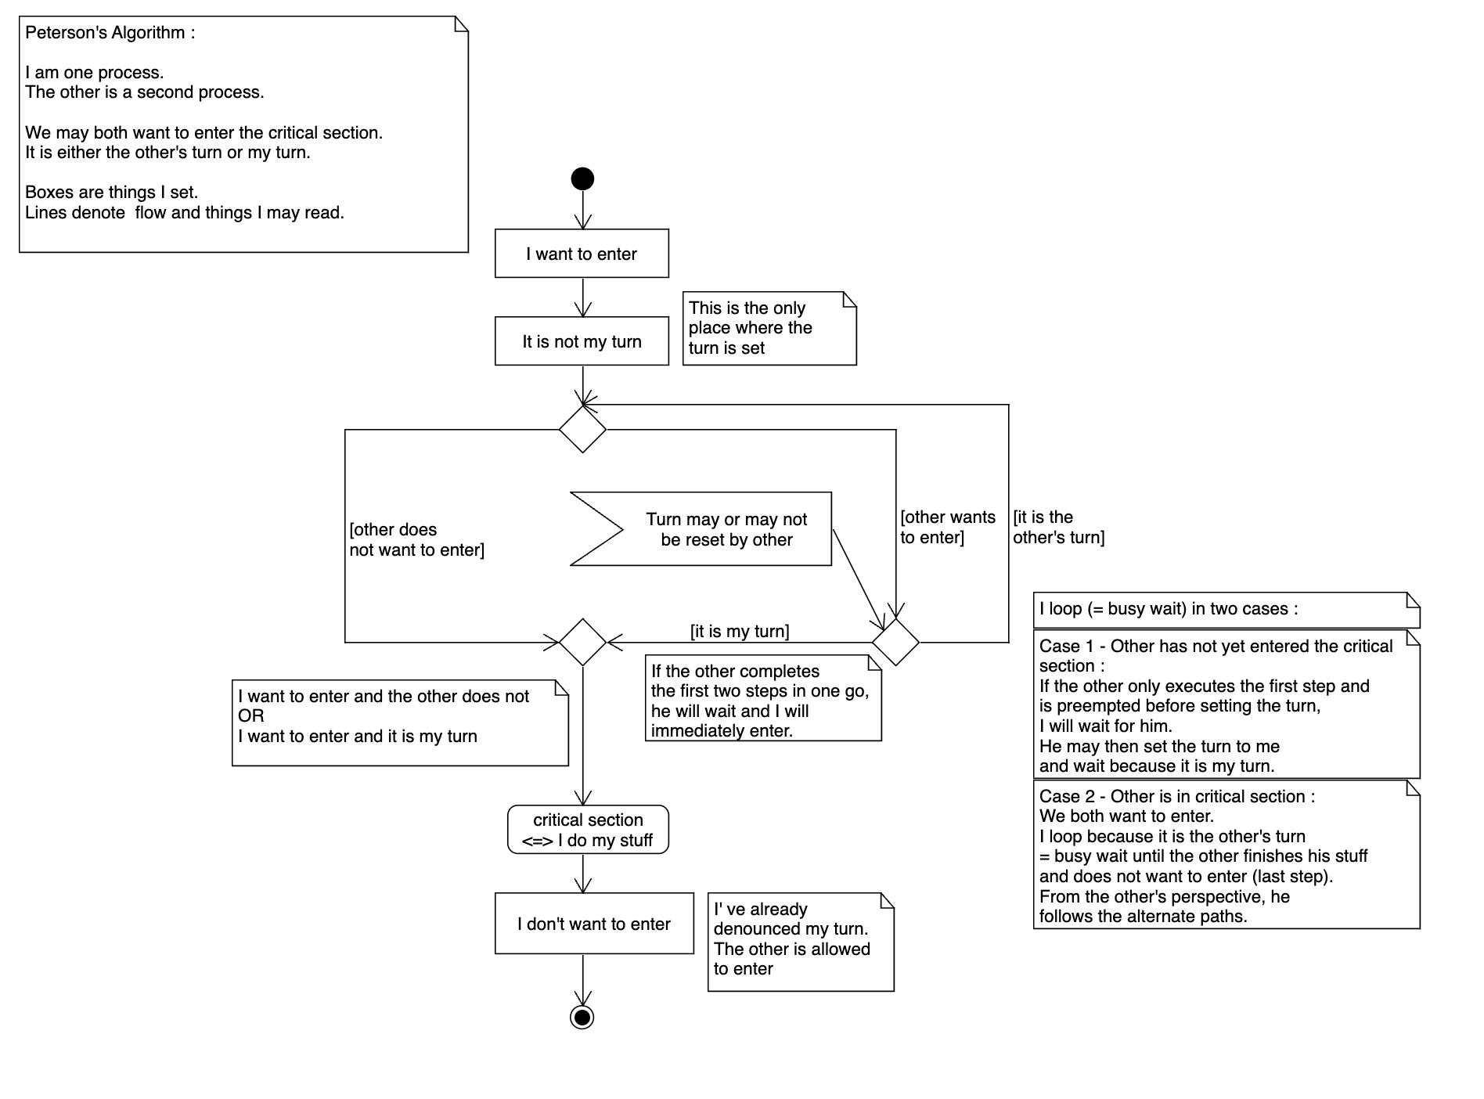
Peterson’s Algorithm

Slide 36
Peterson’s Algorithm
Assume that the load and store machine-language instructions are atomic; that is, cannot be interrupted
The two processes share two variables:
int turn;
Boolean flag[2]
The variable turn indicates whose turn it is to enter the critical section
The flag array is used to indicate if a process is ready to enter the critical section. flag[i] = true implies that process P_{i} is ready!

Slide 37
Critical Section Using Locks
do {
acquire lock
critical section
release lock
remainder section
} while (TRUE);
The handkerchief is the Lock! =)
Few Nuances of Locks:
Lock management has to be fair.
Managed Centrally.
Should allow queues of waiting tasks.

Slide 38
Implementing Locks
A lock is also a variable carrying a state value.
To work with the variable, read and write operations are needed.
These instructions have to be Atomic!
Cannot be preempted out of the CPU.
function TestAndSet(boolean_ref lock) {
boolean initial = lock;
lock = true;
return initial; }

Slide 39
Hardware Support
Many systems provide hardware support for implementing the critical section code.
All solutions below based on idea of locking
Protecting critical regions via locks
Uniprocessors – could disable interrupts
Currently running code would execute without preemption
Generally too inefficient on multiprocessor systems
Operating systems using this not broadly scalable
Modern machines provide special atomic hardware instructions
Atomic = non-interruptible
Either test memory word and set value
Or swap contents of two memory words

Slide 40
Atomic Hardware Instructions - Test & Set
function TestAndSet(boolean_ref lock) {
boolean initial = lock;
lock = true;
return initial;
}
Shared Boolean variable lock, initialized to FALSE
Solution:
do {
while (TestAndSet(&lock)) ; /* do nothing */
/* critical section */
lock = false;
/* remainder section */
} while (true);
Executed atomically
Returns the original value of passed parameter
Set the new value of passed parameter to “TRUE”.

Slide 41
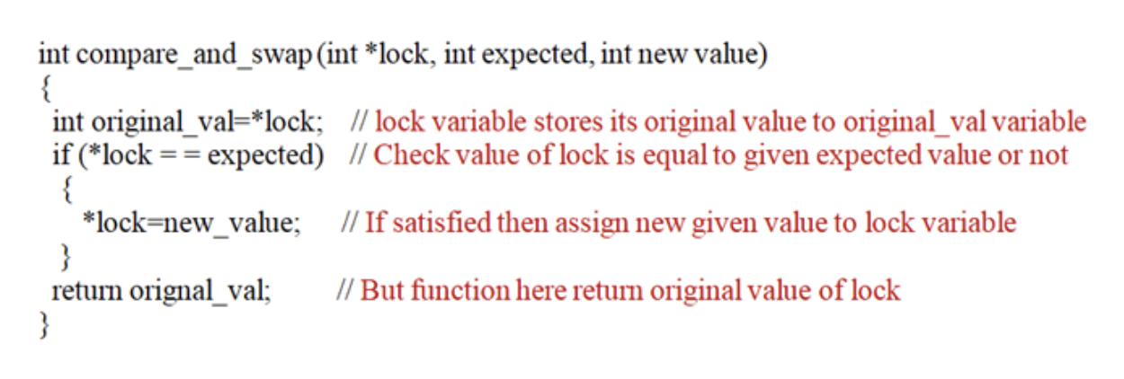
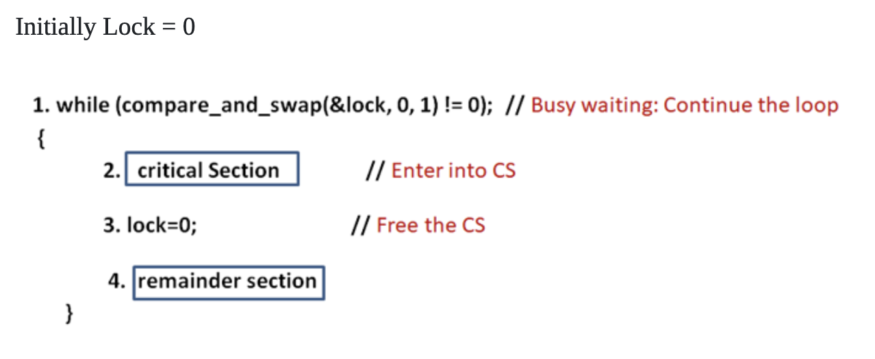
Atomic Hardware Instructions - Compare & Swap
Executed atomically
Returns the original value of passed parameter.
Set the variable “value” the value of the passed parameter “new_value” but only if “value” ==“expected”. That is, the swap takes place only under this condition.
A variant compare_and_set.
Returns boolean indicating if the value was changed.
Functionally same.

Slide 42
How is everyone doing? Still with me? =)

Slide 43

The solutions so far aren’t easy to comprehend!

Slide 44
Mutex Locks
Previous solutions are complicated and generally inaccessible to application programmers
OS designers build software tools to solve critical section problem
Simplest is mutex lock
Protect a critical section by first acquire() a lock then release() the lock
Boolean variable indicating if lock is available or not
Calls to acquire() and release() must be atomic
Usually implemented via hardware atomic instructions
But this solution requires busy waiting
This lock therefore called a spinlock

Slide 45
Mutex Locks
Execution in the Thread
Methods of the Lock Class
do {
acquire lock
critical section
release lock
remainder section
} while (true);
acquire() { while(!available); /* busy wait*/
available = false;
}
release() { available = true; }

Slide 46
Question-3: What if we only need the Induction Stove, the Pan, and Water, and not the spoon? (Reducing the contention on shared objects)
Question-4: Since you cannot communicate with your sibling, how do you pass the message when you are done using the components?

Slide 47
Question-6: What if we have two Induction Stoves, two Pans? How does the coordination happen then?
&&
Mutexes have a problem of Busy Waiting!

Slide 48

Edsger Dijkstra

Slide 49
Semaphores

Slide 50
Semaphores
Synchronization tool that provides more sophisticated ways (than Mutex locks) for process to synchronize their activities.
Semaphore S – integer variable
Can only be accessed via two indivisible (atomic) operations
wait() and signal()
Originally called P() and V()
Definition of the wait() operation
wait(S) {
while (S <= 0)
; // busy wait
S--; }
Definition of the signal() operation
signal(S) {
S++;
}

Slide 51
Semaphores
Counting semaphore – integer value can range over an unrestricted domain
Binary semaphore – integer value can range only between 0 and 1 (Same as a mutex lock)
Can solve various synchronization problems.
Consider P₁ and P₂ that require S₁ to happen before S₂
Create a semaphore “synch” initialized to 0
P1:
S₁;
signal(synch);
P2:
wait(synch);
S₂;
Can implement a counting semaphore S as a binary semaphore

Slide 52
Semaphores
Must guarantee that no two processes can execute the wait() and signal() on the same semaphore at the same time.
With each semaphore there is an associated waiting queue. Tasks are put to Waiting Queue of Scheduler!
Each entry in a waiting queue has two data items:
value (of type integer)
pointer to next record in the list
Two operations:
block – place the process invoking the operation on the appropriate waiting queue
wakeup – remove one of processes in the waiting queue and place it in the ready queue
typedef struct{ int value;
struct process *list;
} semaphore;
wait(semaphore *S) {
S->value--;
if (S->value < 0) { add this process to S->list;
block(); }
}
signal(semaphore *S) {
S->value++;
if (S->value <= 0) { remove a process P from S->list;
wakeup(P); }
}

Slide 53
Semaphores Examples

Slide 54
Lecture-5

Slide 55
Recap: Lecture-4

Slide 56
Few Questions to ponder upon!
Can you and your sibling use the Common Components together?
Do you need the Common Components from the beginning until the end of your recipe?
If not, how do you enforce an order or sequence on it?
What if we only need the Induction Stove, the Pan, and Water, and not the spoon? (Reducing the contention on shared objects)
Since you cannot communicate with your sibling, how do you pass the message when you are done using the components?
What if we have two Induction Stoves, two Pans? How does the coordination happen then?
Let’s dive in!

Slide 57
Orderly Execution
What if two transfers are triggered at the same time? (to the nanosecond)
Race Condition
A race condition is a condition of a program where its behavior depends on relative timing or interleaving of multiple threads or processes. One or more possible outcomes may be undesirable, resulting in a bug. We refer to this kind of behavior as nondeterministic.

Slide 58
Critical Section
Thread-1
Take packet(s) of Maggi, and a bowl.
Gather a Washed Pan, Spoon, Induction Stove, Water.
Add Water to the Pan.
Heat the water for 30 seconds.
Add the Maggi Masala and stir it with the spoon.
Let the water and masala boil for 20 seconds.
Break the Maggi cake into two.
Add to the pan.
Stir the Maggi every few seconds.
Keep heating until the water has evaporated and the noodles have softened up.
Turn off the induction Stove.
Pour the Maggi into a bowl, and eat.
Critical Section

Slide 59
Critical Section - Theoretical Construct
1. Mutual Exclusion - If process P_{i} is executing in its critical section, then no other processes can be executing in their critical sections
2. Progress - If no process is executing in its critical section and there exist some processes that wish to enter their critical section, then the selection of the processes that will enter the critical section next cannot be postponed indefinitely
3. Bounded Waiting - A bound must exist on the number of times that other processes are allowed to enter their critical sections after a process has made a request to enter its critical section and before that request is granted
Assume that each process executes at a nonzero speed
No assumption concerning relative speed of the n processes
Mutex === Mutual Exclusion

Slide 60
Peterson’s Algorithm
Two Variables
Flag - Representing Readiness
Turn - Whose turn is it.

Slide 61
Atomic Hardware Instructions - Test & Set
function TestAndSet(boolean_ref lock) {
boolean initial = lock;
lock = true;
return initial;
}
Shared Boolean variable lock, initialized to FALSE
Solution:
do {
while (TestAndSet(&lock)) ; /* do nothing */
/* critical section */
lock = false;
/* remainder section */
} while (true);
Executed atomically
Returns the original value of passed parameter
Set the new value of passed parameter to “TRUE”.

Slide 62
Atomic Hardware Instructions - Compare & Swap
Executed atomically
Returns the original value of passed parameter.
Set the variable “value” the value of the passed parameter “new_value” but only if “value” ==“expected”. That is, the swap takes place only under this condition.
A variant compare_and_set.
Returns boolean indicating if the value was changed.
Functionally same.

Slide 63
Mutex Locks
Execution in the Thread
Methods of the Lock Class
do {
acquire lock
critical section
release lock
remainder section
} while (true);
acquire() { while(!available); /* busy wait*/
available = false;
}
release() { available = true; }

Slide 64
Mutex Locks
Previous solutions are complicated and generally inaccessible to application programmers
OS designers build software tools to solve critical section problem
Simplest is mutex lock
Protect a critical section by first acquire() a lock then release() the lock
Boolean variable indicating if lock is available or not
Calls to acquire() and release() must be atomic
Usually implemented via hardware atomic instructions
But this solution requires busy waiting
This lock therefore called a spinlock

Slide 65
Semaphores
Must guarantee that no two processes can execute the wait() and signal() on the same semaphore at the same time.
With each semaphore there is an associated waiting queue. Tasks are put to Waiting Queue of Scheduler!
Each entry in a waiting queue has two data items:
value (of type integer)
pointer to next record in the list
Two operations:
block – place the process invoking the operation on the appropriate waiting queue
wakeup – remove one of processes in the waiting queue and place it in the ready queue
typedef struct{ int value;
struct process *list;
} semaphore;
wait(semaphore *S) {
S->value--;
if (S->value < 0) { add this process to S->list;
block(); }
}
signal(semaphore *S) {
S->value++;
if (S->value <= 0) { remove a process P from S->list;
wakeup(P); }
}

Slide 66
Lecture-5: Live Examples of Synchronisation Primitives!

Slide 67
CountdownLatch vs Barrier

Slide 68
CountdownLatch vs Barrier
Barrier: Tasks arrive at a barrier and wait for all other tasks to arrive. They are released together and proceed to do their work thereafter. Essentially signifies completion of tasks running in parallel, and all the tasks are similar in nature.
CountdownLatch: One Task is waiting for a certain number of events/operations to occur in other Tasks for it to proceed further. The waiting Task, and Tasks that will signal the event are not similar in nature.

Slide 69
Producer Consumer Problem

Slide 70
Task Communication
Processes within a system may be independent or cooperating.
Independent process cannot affect or be affected by the execution of another process.
Cooperating process can affect or be affected by other processes, including sharing data.
Reasons for cooperating processes:
Information sharing
Computation speedup
Modularity
Convenience
Cooperating processes need interprocess communication (IPC).
Two models of IPC
Shared memory
Message passing

Slide 71
Task Communication
Message Queues & Shared Memory

Slide 72
Producer Consumer Construct
Two (or more) tasks have to share information with each other.
The Task sending the information is called Producer.
The Task receiving the information is called Consumer.
There has to be a shared location/variable through which information is exchanged.
Buffer
Queue
This location can be:
Unbounded (unlimited in Size) – Theoretical
Bounded (Limited Size) - Practical

Slide 73
Does the Shared Variable/Location remind you of something?

Slide 74
Does the Shared Variable/Location remind you of something?
The Shared Variable has to be protected.

Slide 75
Does the Shared Variable/Location remind you of something?
The Shared Variable has to be protected.
It’s a standard critical section problem that needs Synchronisation to solve.

Slide 76
Can someone to suggest possible solutions to the Producer-Consumer Problem?

Slide 77
Producer Consumer Problem is present all around us. Wherever you see Queues, there is potentially a Producer Consumer Problem!

Slide 78

Shall we take a 5-mins break?

Slide 79
Short Detour: Queueing Theory
Little’s Law

Slide 80
Advanced Synchronisation Problems

Slide 81
Advanced Synchronisation Problems
Bounded-Buffer Problem/Producer Consumer Problem
Readers and Writers Problem
Dining-Philosophers Problem

Slide 82
Advanced Synchronisation Problems
Bounded-Buffer Problem/Producer Consumer Problem
Readers and Writers Problem
Dining-Philosophers Problem

Slide 83
Advanced Synchronisation Problems
Bounded-Buffer Problem/Producer Consumer Problem
Readers and Writers Problem
Dining-Philosophers Problem

Slide 84
Readers and Writers Problem

Slide 85
Readers-Writers Problem
A data set is shared among a number of concurrent processes
Readers – only read the data set; they do not perform any updates
Writers – can both read and write
Problem – allow multiple readers to read at the same time
Only one single writer can access the shared data at the same time
Several variations of how readers and writers are considered – all involve some form of priorities.
Could you think of any real-life examples?

Slide 86
Readers-Writers Problem - Solution Template
Shared Data
Data Set (That has to be read/written)
Semaphore rw_mutex initialized to 1 → Synchronize between Writers and Readers
Integer read_count initialized to 0 → Represents number of Readers.
Semaphore reader_count_mutex initialized to 1 → Protect the read_count variable.

Slide 87
Readers-Writers Problem - Solution Template
Writer
do { wait(rw_mutex);
... /* writing is performed */
...
signal(rw_mutex);
} while (true);
Reader
do { wait(mutex); read_count++; if (read_count == 1)
wait(rw_mutex);
signal(mutex); /* reading is performed */
wait(mutex); read count--; if (read_count == 0)
signal(rw_mutex);
signal(mutex);
} while (true);

Slide 88
Can you think of real-life applications of Readers and Writers Problem?

Slide 89
Advanced Synchronisation Problems
Bounded-Buffer Problem/Producer Consumer Problem
Readers and Writers Problem
Dining-Philosophers Problem

Slide 90
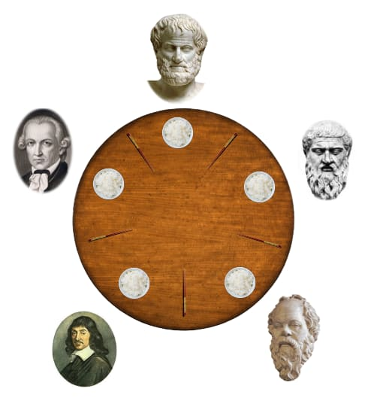
Dining Philosophers Problem
Philosophers spend their lives alternating thinking and eating
Don’t interact with their neighbors, occasionally try to pick up 2 chopsticks (one at a time) to eat from bowl
Need both to eat, then release both when done

Slide 91
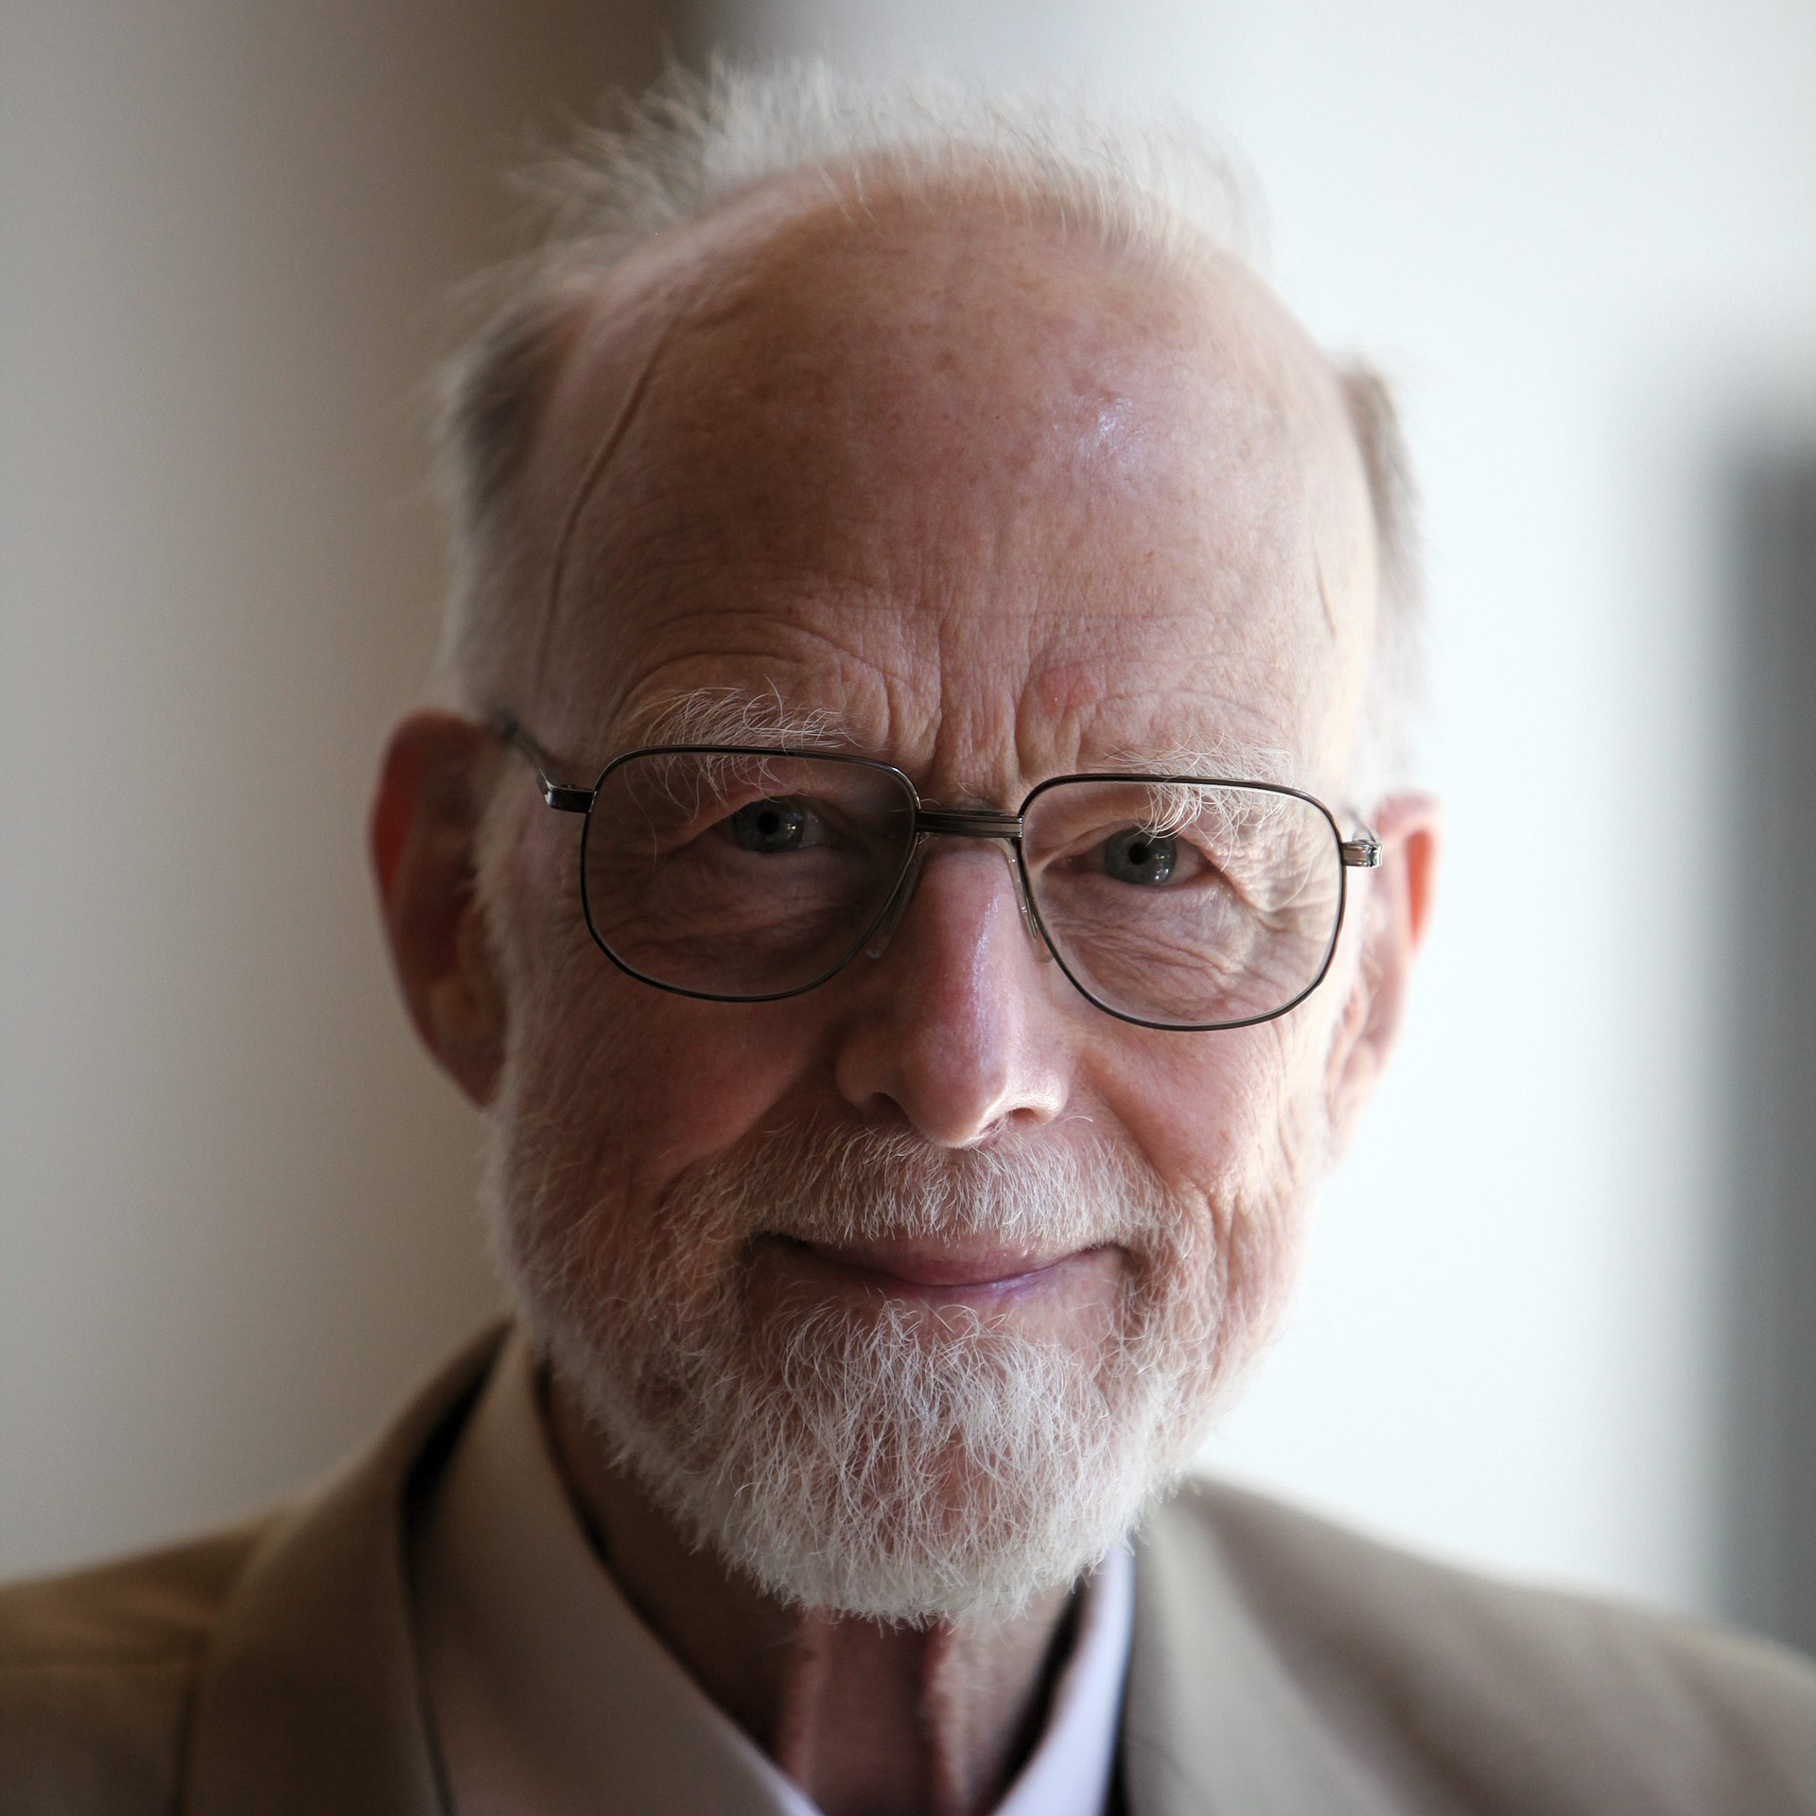
Sir Tony Hoare
Inventor of QuickSort, Process Algebra, Hoare Logic, and the list goes on.

Slide 92
Dining Philosophers Problem
Formulated to showcase how synchronisation problems have to be reasoned with.
Can lead to Starvation, Deadlocks, etc.
Shall we cover it in a later session?

Slide 93
Specialised Application Processes

Slide 94
Specialised Application Processes
Specific purpose for internet systems.
Web-Servers (HTTP/HTTPS)
Email Servers (SMTP)
File Servers (FTP)
Interesting Designs and interplay of Tasks.
Maximise Throughput, and Performance.
Concurrency Constructs underpin the design.

